Slide 1


Department of Electronics and Communication Engineering
Embedded Web Server on LPC2148
BUILT BY:
Swaminath B - 225807064
Anirudh Nishtala - 225807128
Rishiraj Kumar - 225807062
Sumedh Prabhudesai - 225807036

Slide 2
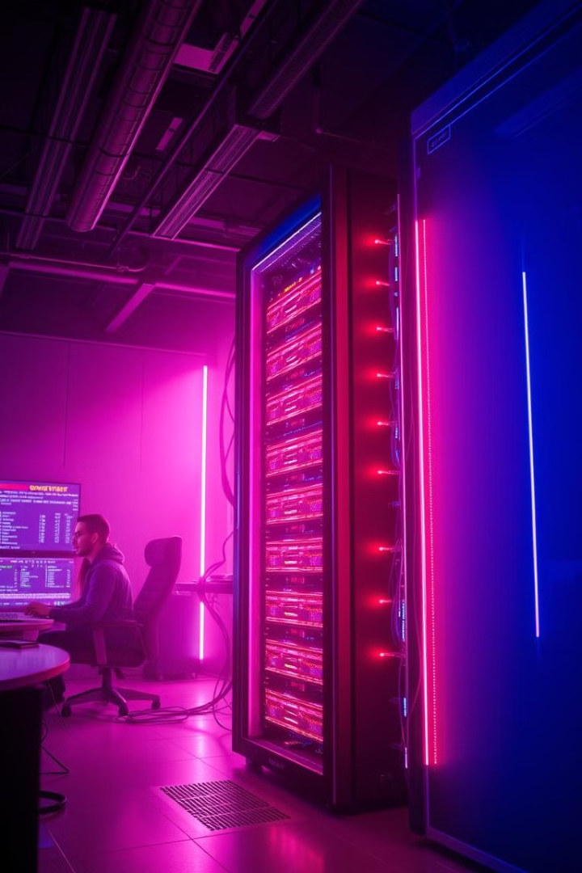
Introduction
1
Embedded Web Server
2
Data Transmission
The ENC28J60 Ethernet module facilitates smooth and reliable data transmission between the server and a remote user interface.
The project aims to create a compact and efficient embedded web server, leveraging the capabilities of the LPC2148 microcontroller.
3
Real-Time Simulation
The system is designed to simulate real-time data, replicating the behavior of industrial or electronic equipment for testing and analysis.

Slide 3
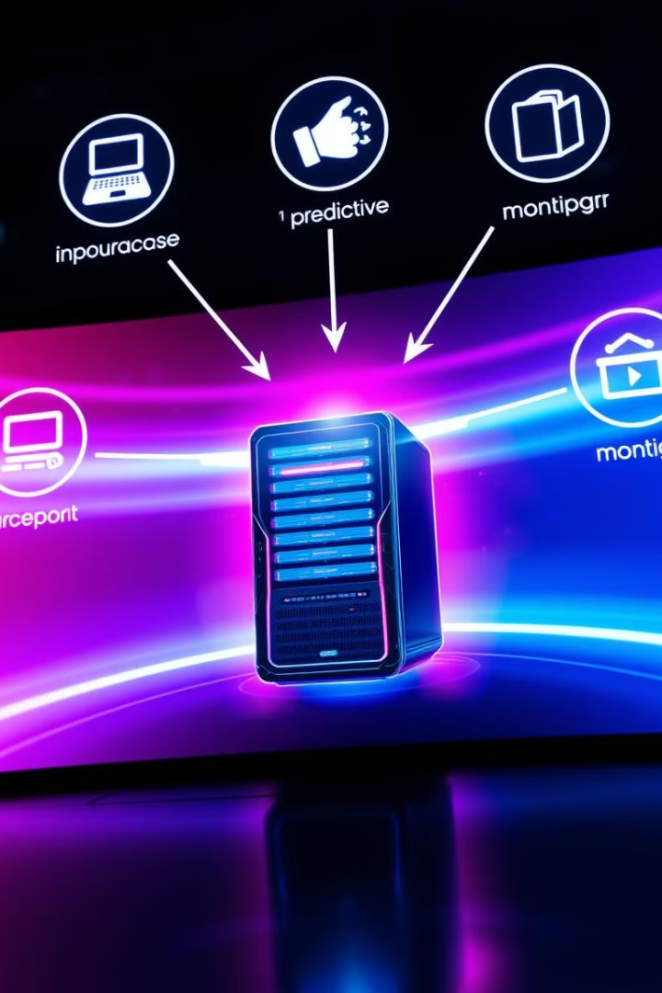
Objectives
Real-Time Monitoring
Predictive Analytics
The web server provides a user interface for continuous monitoring of simulated sensor data, replicating real-world conditions.
The system leverages data analytics to predict potential failures in the simulated equipment based on real-time data trends.

Slide 4
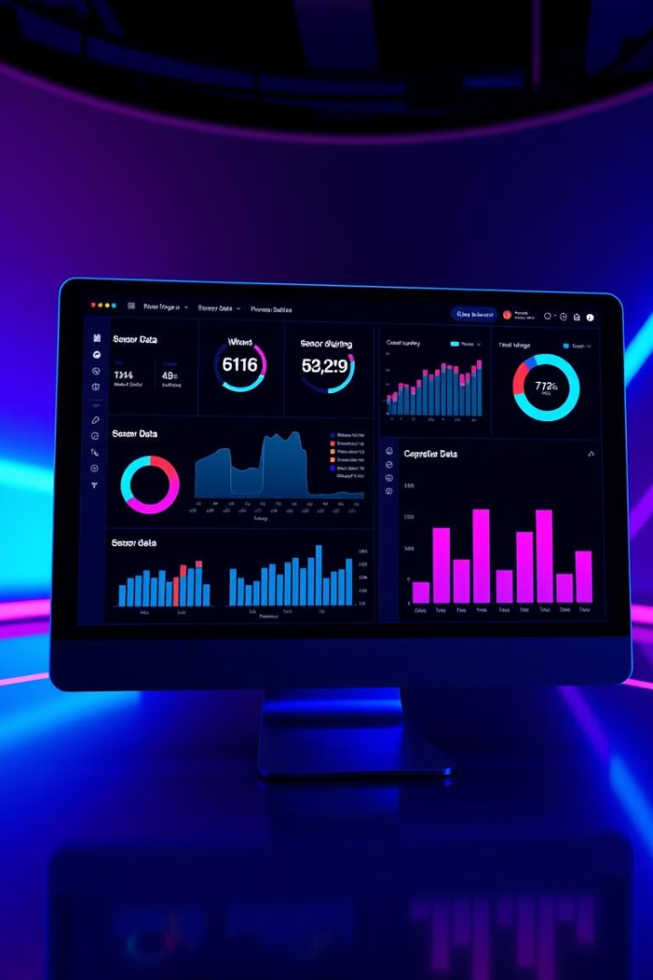
Objectives Achieved
1
Sensor Data Simulation
The project successfully implements a sensor data simulation system, generating real-time data that mimics industrial or electronic equipment.
2
Front-End UI Development
A user-friendly front-end interface was developed, providing visual representation of the simulated data and enabling user interaction.
3
Database Integration
The simulated sensor data is seamlessly integrated with a backend database, facilitating data storage, retrieval, and analysis.
4
UI-Database Interaction
The front-end UI interacts with the backend database, retrieving and displaying the simulated sensor data in real-time.

Slide 5
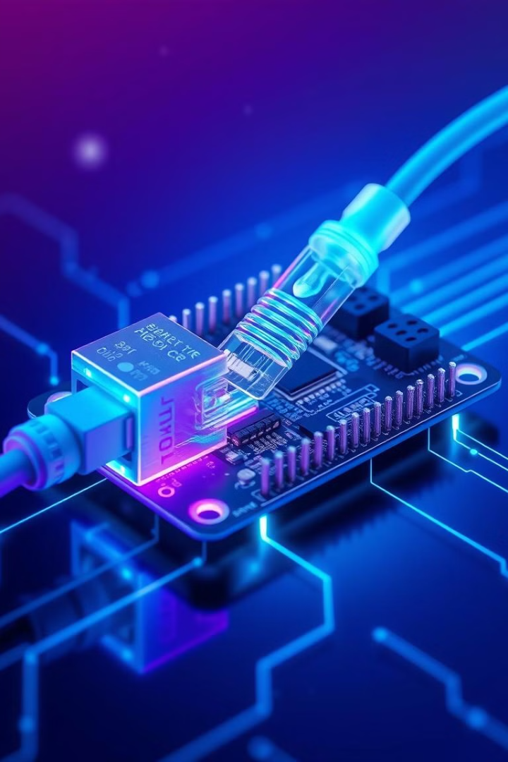


Work to be Completed
Web Server Deployment
The compiled .hex file of the web server will be deployed onto the LPC2148 microcontroller.
Integration with UI and Database
The deployed web server will be integrated with the front-end UI and the backend database, enabling the server to communicate and provide data to the user interface and access/update simulated sensor data in real-time.

Slide 6
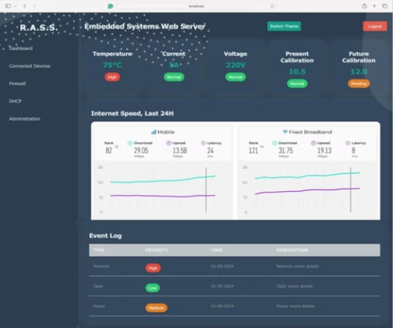
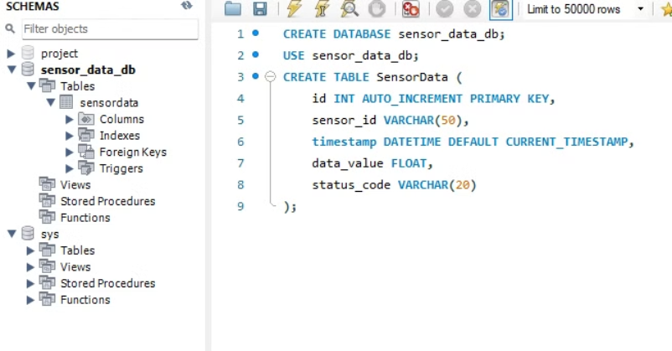
Front-End and Database Snippets
Front-End UI Snippet
Database Snippet
The snippet shows a section of the front-end code responsible for displaying the simulated data from the database on a webpage.
The snippet showcases a section of the database code that defines the structure for storing the simulated sensor data, including fields for timestamp, sensor ID, and measured values.

Slide 7
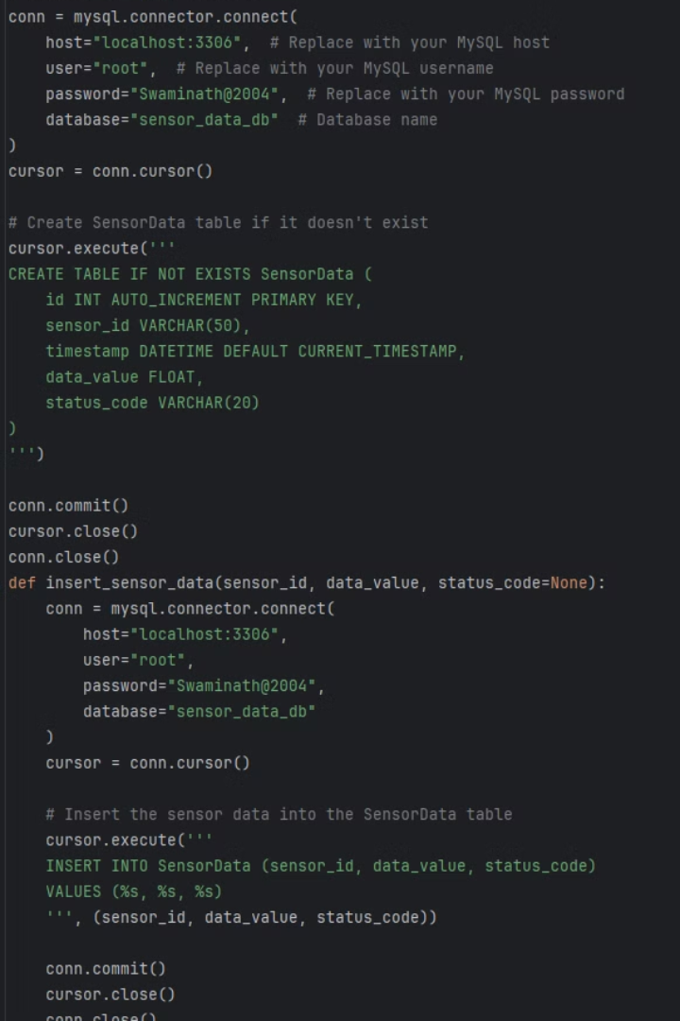
Backend Server Code Snippet
Web Server Code Snippet
Database Interaction Code Snippet
This code snippet illustrates a portion of the web server's code responsible for handling HTTP requests, processing data, and generating web pages.
This same code snippet shows a portion of the server's code responsible for interacting with the database, retrieving, and updating simulated sensor data.

Slide 8
References
https://www.youtube.com/watch?v=Z1RJmh\\_Oqe
https://mongoose.ws/reference-projects/
https://embetronicx.com/tutorials/microcontrollers /lpc2148/ultrasonic -sensor -interfacing -with - lpc2148/
https://www.electronicshub.org/embedded - systems -projects -ideas/
https://ijates.com/images/short\_pdf/1396953085\_ P31 -36.pdf
https://www.irdindia.in/journal\\\_ijraet/pdf/vol1\\\_iss 1/3.pdf

Slide 9

Thank You
This project showcases the capabilities of embedded web servers in industrial settings, paving the way for efficient remote monitoring and data-driven decision-making. This presentation serves as a stepping stone for further exploration and development in this domain.

